Slide 1

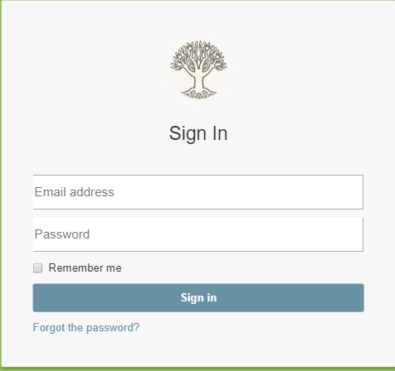

MUM Room Management System
By:Joseph Tusoy
William Chaparro
Binyam Heyi

Slide 2
Outline
The Problem
Solution and Demo
Next Steps

Slide 3
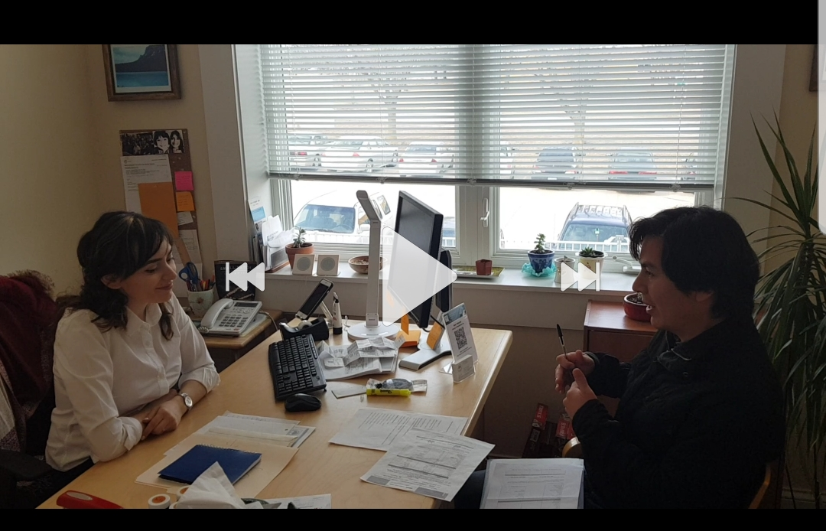
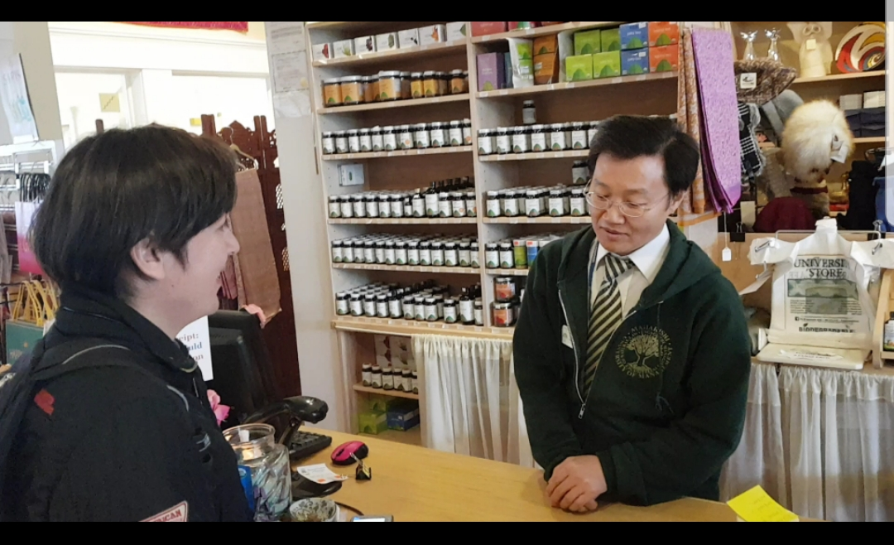
Problem statement
Paper based
Not centralized
Cumbersome

Slide 4
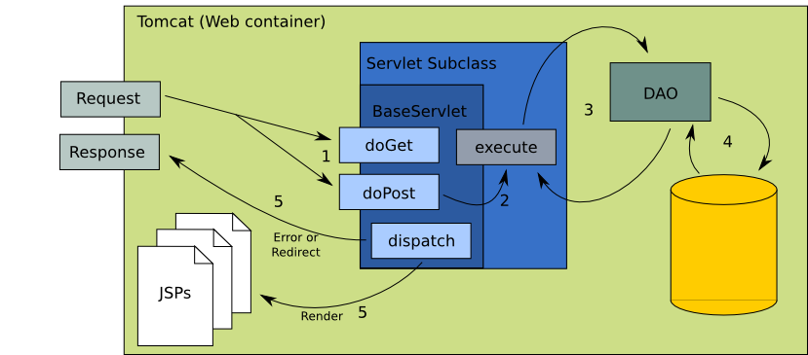
Solution
We tackle the problem as an MVC
Data (Model)
An interface to view and modify the data (View)
Operations that can be performed on the data (Controller)
Notes:
Dicribe them in detai….

Slide 5
Responsibility
Binyam H: Mostly on UI ( FE)
William C: Backend and Integration
Joseph T: Backend and Integration

Slide 6
Components
Database: MySQL
View: JSP, HTML ,CSS ,JS, JQuery, JQGrid, Bootsrap, ajax
Model: Java Beans, Bundle, DAO.
Controller: Login, Student, Report, Request, Room, utilities
Notes:
Dicribe them in detai….

Slide 7
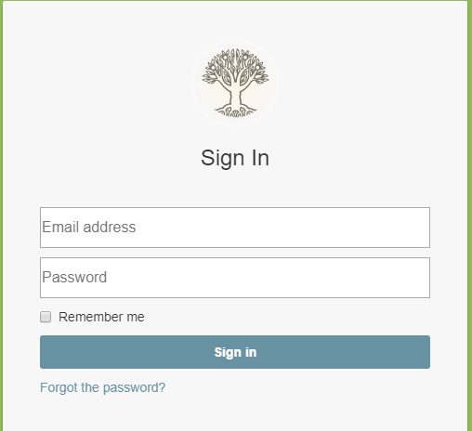
Sign In Screen

Slide 8
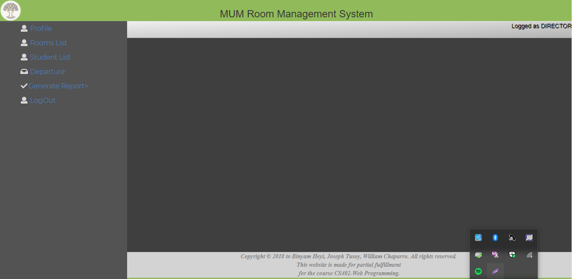

Slide 9
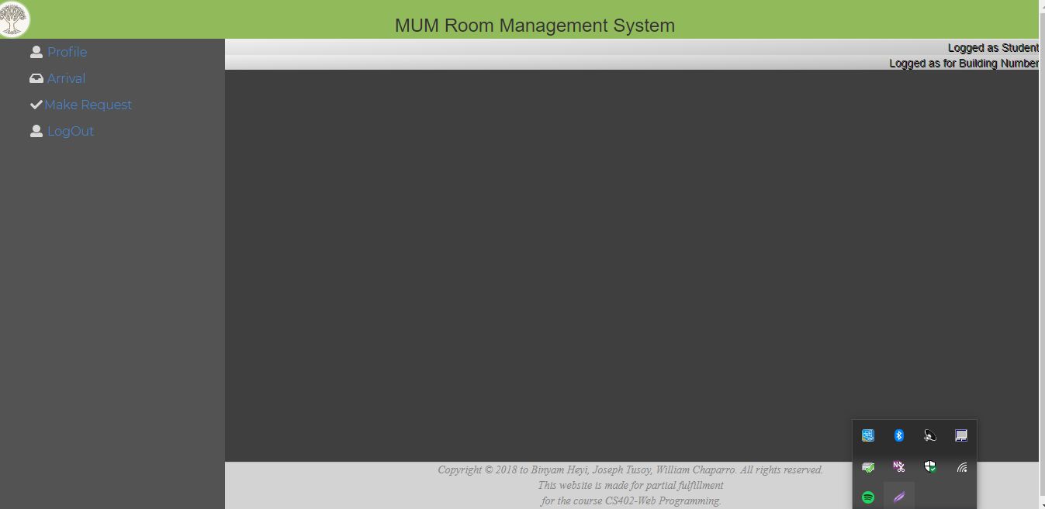
Articulate your design decisions by adding justifications

Slide 10
Demo

Slide 11
Questions?
After all we all are a product of ____

